Slide 1
CLASSIFICATION
Machine Learning
BS_AI 007
Muhammad wahaaj siddique

Slide 2

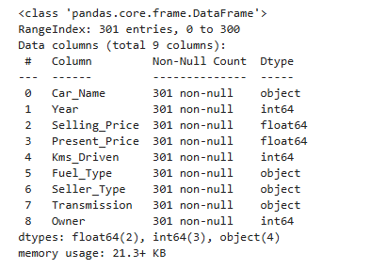

STEP # 1

Slide 3
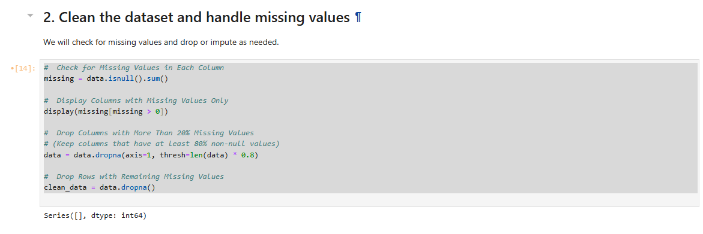
STEP # 2

Slide 4
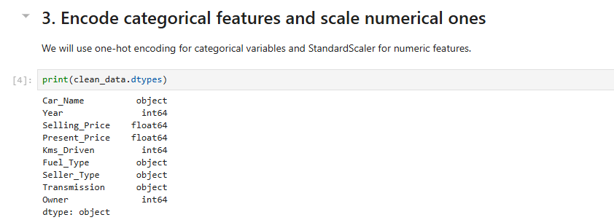
STEP # 3

Slide 5

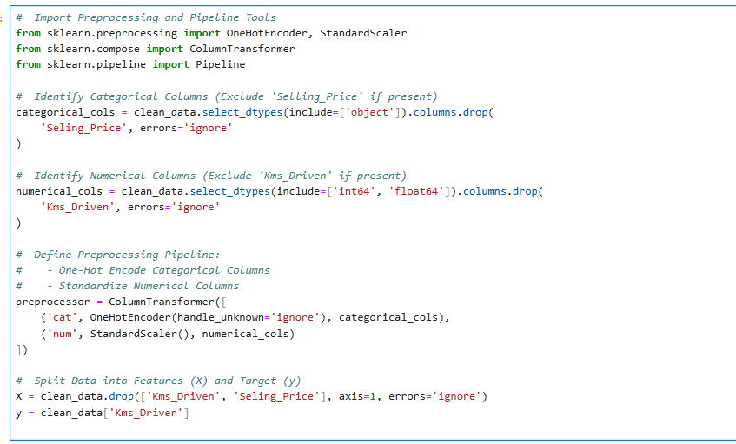
STEP # 3

Slide 6

STEP # 4

Slide 7
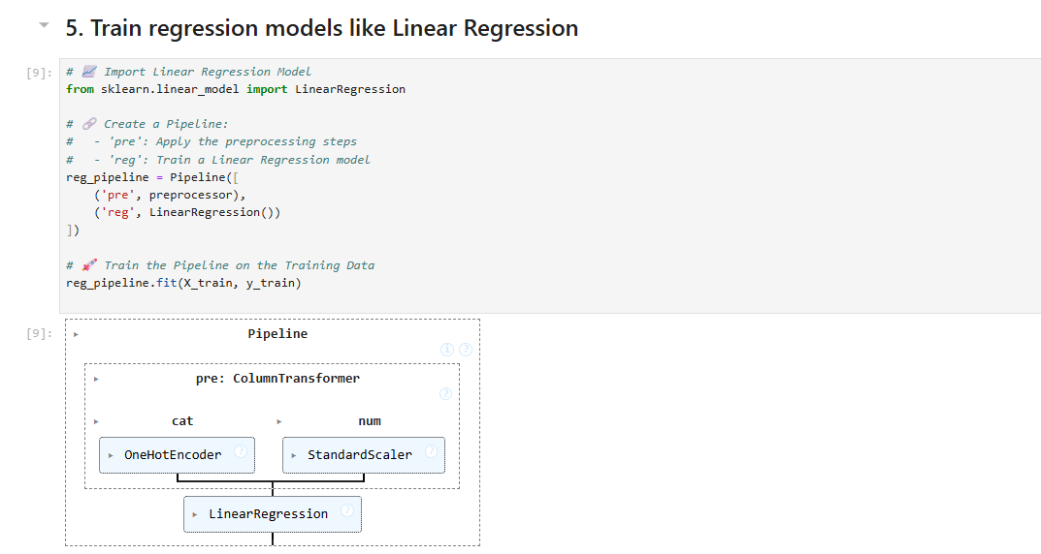
STEP # 5

Slide 8
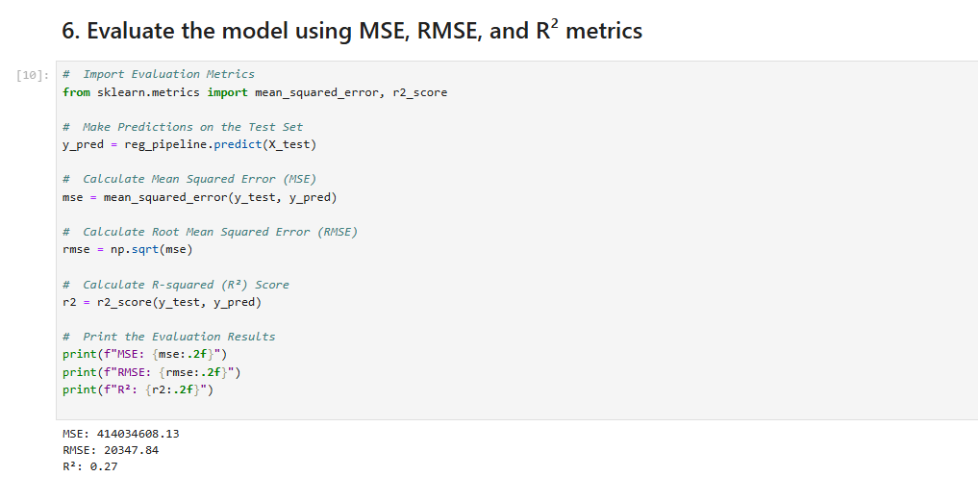
STEP # 6

Slide 9
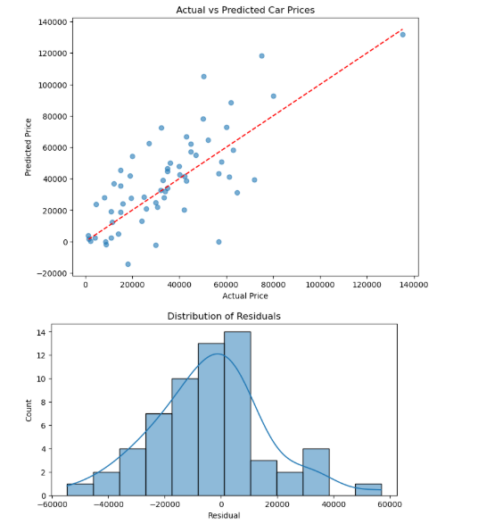
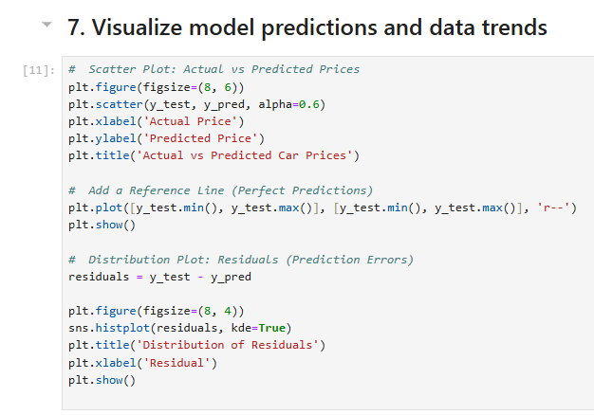
STEP # 7

Slide 10
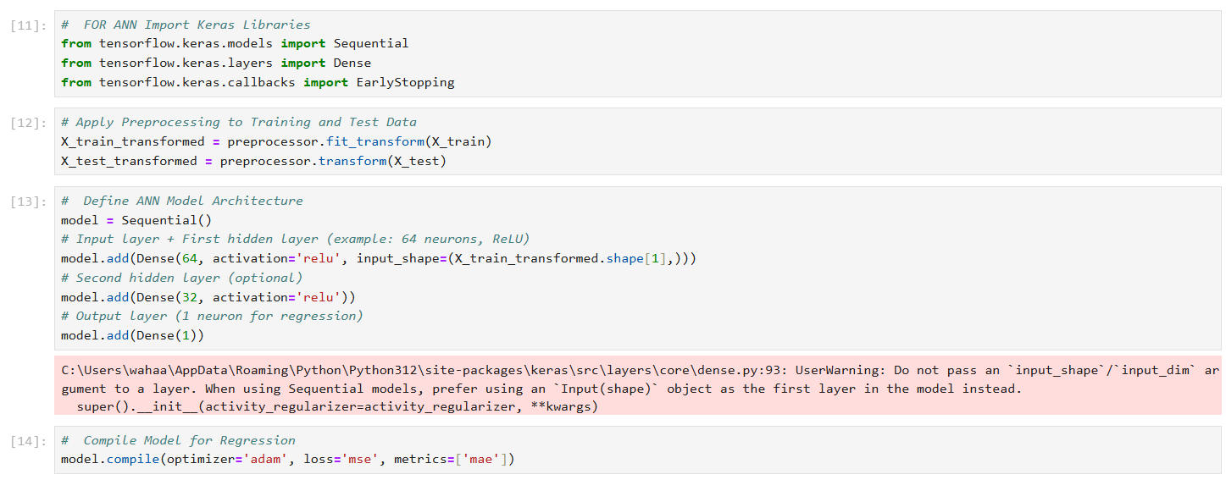
STEP # 8

Slide 11
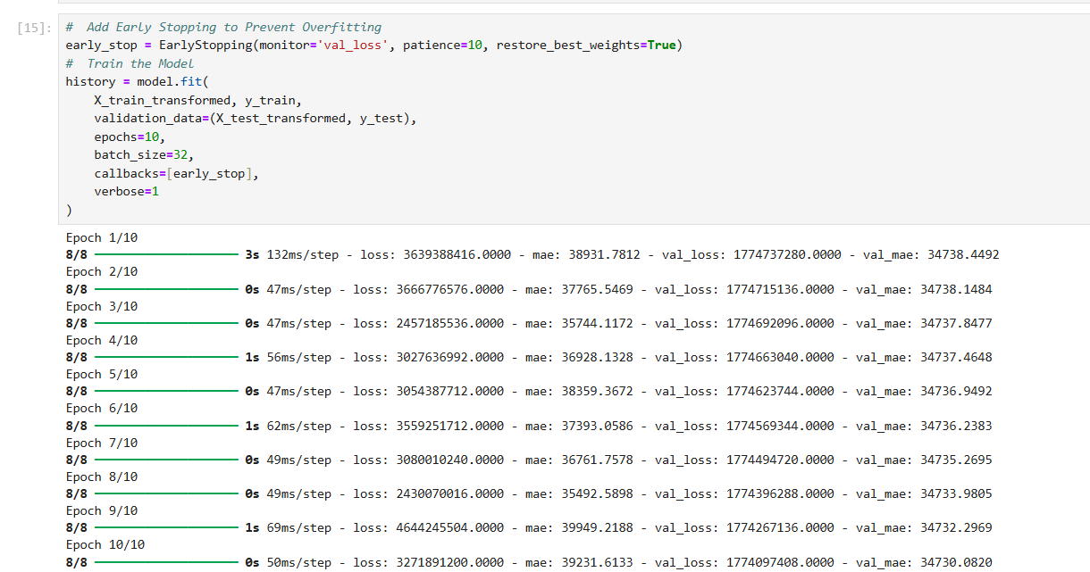
STEP # 8

Slide 12
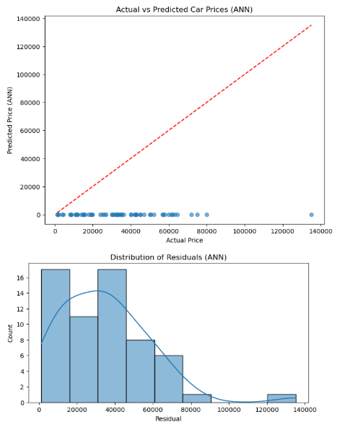
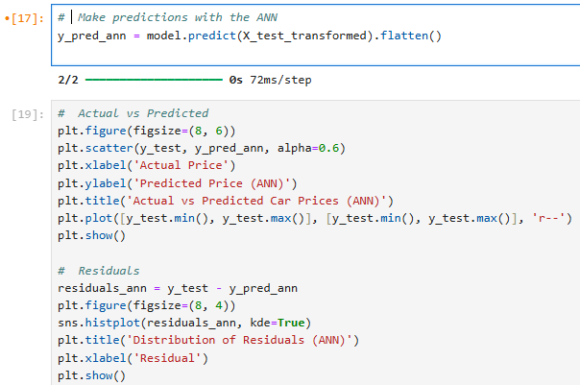
STEP # 8

